Slide 1
Update on Fort Worth Botanic Garden Strategic Plan
Presented January 30, 2018
Richard Zavala, Director, Park and Recreation Department
Pat Harrison, Senior Vice President for Education, BRIT

Slide 2
Strategic Plan Overview Refer the Plan to the City Manager and staff for further review and evaluation to develop strategies and policies for the implementation of the Plan.
Realign governance and existing financial resources
Identify needed capital infrastructure costs
Assemble more visitor information
Notes:
November 15, 2016 – City Council authorized acceptance of the Plan: Refer the Plan to the City Manager and staff for further review and evaluation, Implement actions for realigning governance and existing financial resources,
Recognize the long history of dedication and commitment by support groups
FWBS and FWGC directly fund and conduct visitor intercept surveys
Authorize $350,000 from available funds for facilities assessment
C-28127 Authorize Execution of a Professional Services Agreement with Elements of Architecture, Inc., in the Amount of $350,000.00, to Conduct an Assessment of Facility Conditions at the Fort Worth Botanic Garden
Intercept study – 10 to 12 minutes, will begin February. Random days and random times., 400 total surveys per quarter

Slide 3
Accomplishments
Setup Special Revenue Fund for Fort Worth Botanic Garden
Redirect income currently flowing to support groups and for contract maintenance services and operational support
City assumes expenses (and corresponding revenues to fund positions)
Identify needed capital infrastructure costs
Assemble more visitor information
Notes:
FY2018 Budget included funds from all revenue sources.
FY2017 - $2.86M General Fund
FY2018 - $5.60M Special Revenue Fund
63 Authorize positions
100-200 Funds – FWBS - Tinsley Trust and other organizations such as: Orchid, Cactus, Iris, Begonia, BS Endowment; and FWGC - Garden Center Committee ; Plus existing balance of revenues earned from Botanic Garden facilities and programs which have no restrictions because they have been received as general revenue. The amounts estimated at this juncture include: 1. FWGC $100K; and 2. FWBS: $500K-$1M
February 21, 2017 CC authorized Execution of a Professional Services Agreement with Elements of Architecture, Inc., in the Amount of $350,000, to Conduct an Assessment of Facility Conditions at the Fort Worth Botanic Garden, M&C C-28127
Visitor intercept survey- Began on February 10, 2017. Face-to-face surveys conducted on random days and times. A total of 400 surveys per quarter. Funded at cost of $37K by FWBS and FWGC.
Report has been received. Staff still reviewing and will present to City Council at later date.
Report has been received. Staff still reviewing and will present to City Council at later date.

Slide 4
Strategic Plan Next Steps
Program partnership with BRIT (education and volunteer programs)
Explore the establishment of, or partnership with, a non-profit entity
Notes:
This will be the focus of today’s presentation. I turn the presentation over to Pat Harrison, Senior Vice President for Education with BRIT

Slide 5
Program Partnership
Benchmarking
Marketing strategy
360 Review – data collection
Stakeholder meetings – education and volunteer
Education peer review
Notes:
Data from APGA
Will discuss more on a later slide
In preparation for the strategic plan, an extensive data collection of ????????????????? Took place at BRIT during July and August 2017
Education – Master Gardeners, FWISD science administrator, BRIT and BG staff, FWSSR; Volunteers – BG and BRIT

Slide 6
Nature and science rooted in the culture of community.
The “Grow” collaborative offers meaningful experiences through education and volunteer opportunities that enrich personal growth and sustain our planet.
Get back to your roots.
Never stop Growing!

Slide 7
Together, We are Growing …
Volunteers Cultivate
Conserve
Explore
Engage
SEED School Children & Families
PreK-5 Schools
Youth
Teachers
Adult Ed
Botany, ecology & nature
Botanical arts & crafts
Food, health & wellness
Horticulture & gardening

Slide 8
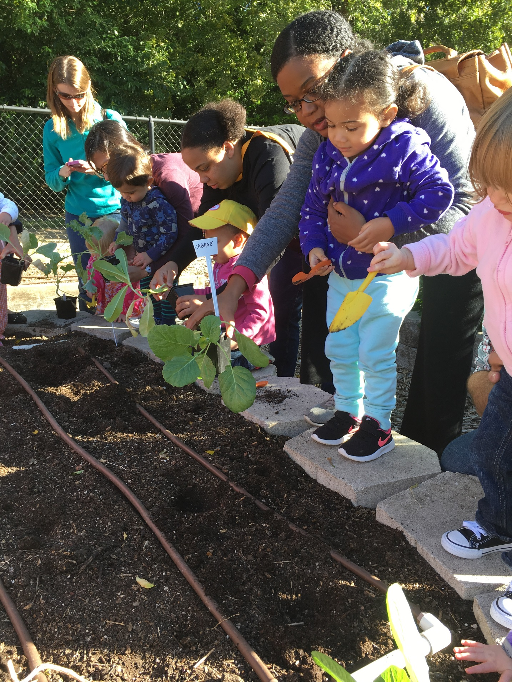
Education’s commitment for GROWING programs includes….
Engaging families through culturally diverse experiences
Literacy: weaving science, nature, and language into outdoor experiences
GROWing core program capacities to serve more individuals in the community

Slide 9
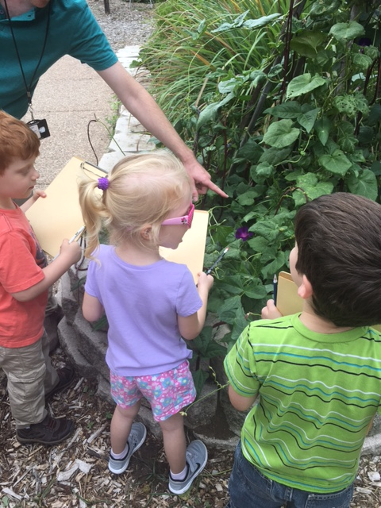
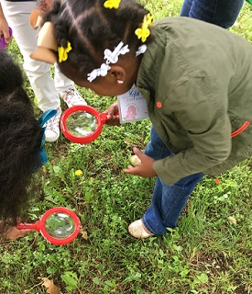
First Quarter results - Education
Children and Families
Q1: Oct-Dec 2017
15 programs
1271 participants
5800 engagement hours
Bella’s Book & Nature Club
Sprouts & Seedlings
Notes:
Pat – we were recommending to not use slide #10. If you want to hand something out on this you could.

Slide 10
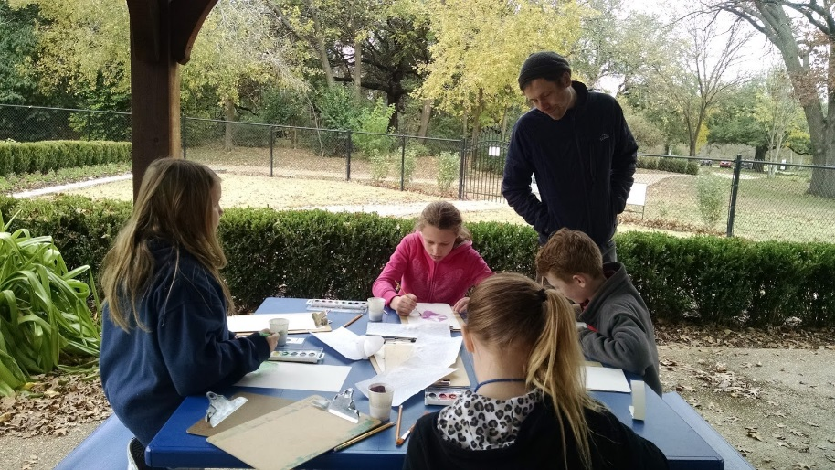
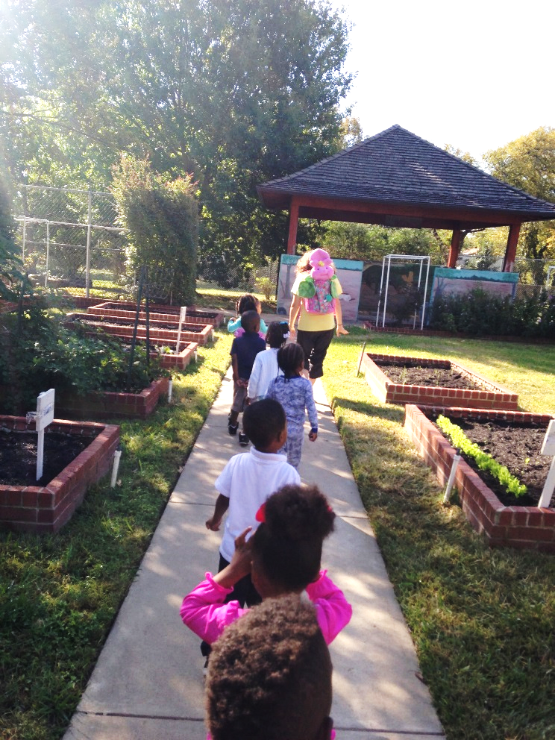
First Quarter results - Education
School field trips to the Garden
Schools: PreK-5
Q1: Oct – Dec 2017
41
programs
898 participants
7928 engagement hours
Bella visits preschools in FWISD
Notes:
Pat – we were recommending to not use slide #10. If you want to hand something out on this you could.

Slide 11
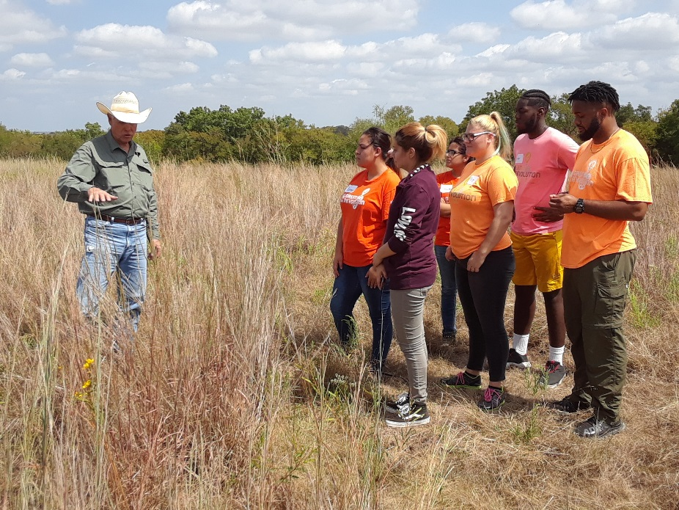
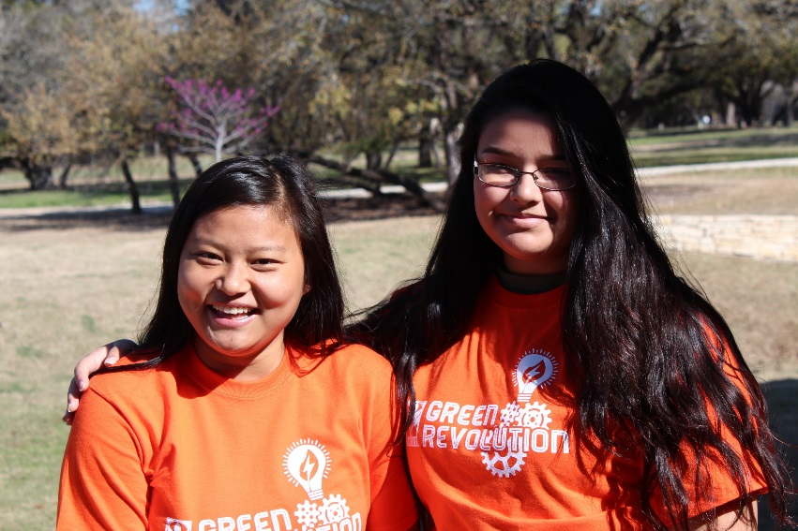
Green Revolution After School and Saturday Explorations
Urban Agriculture Day
Youth
Q1: Oct – Dec 2017
35
programs
479
participants
2064 engagement hours
Notes:
Pat – we were recommending to not use slide #10. If you want to hand something out on this you could.

Slide 12
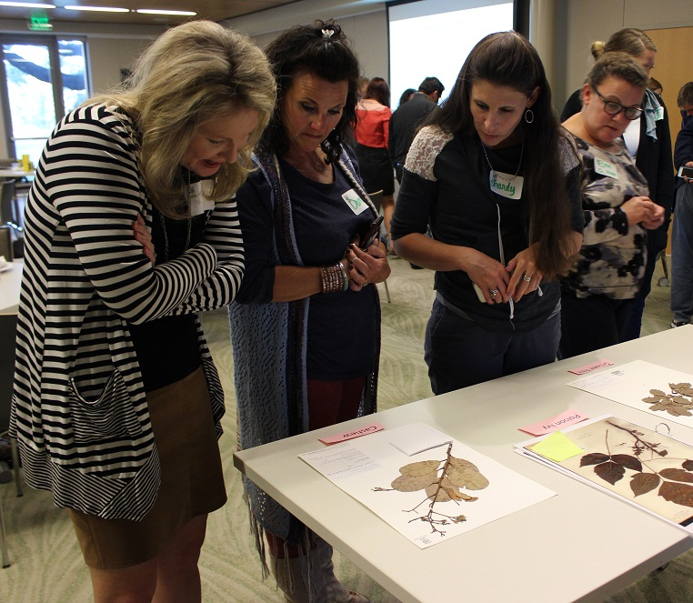
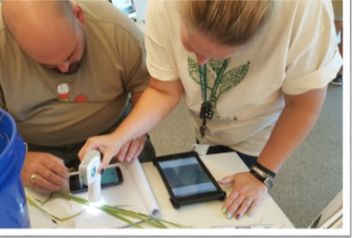
E STEM Boot Camp
Teacher Tuesday
Teachers
Q1: Oct – Dec 2017
35
programs
128
participants
507 engagement hours
Notes:
Pat – we were recommending to not use slide #10. If you want to hand something out on this you could.

Slide 13
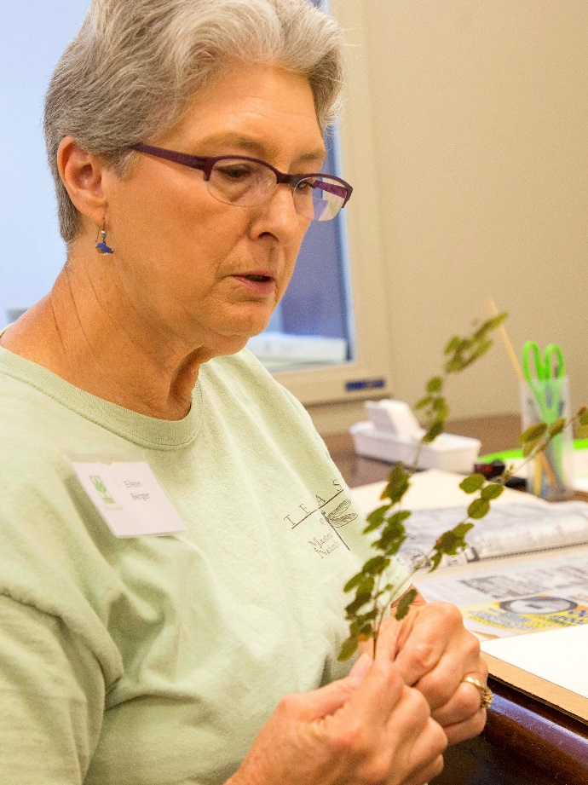
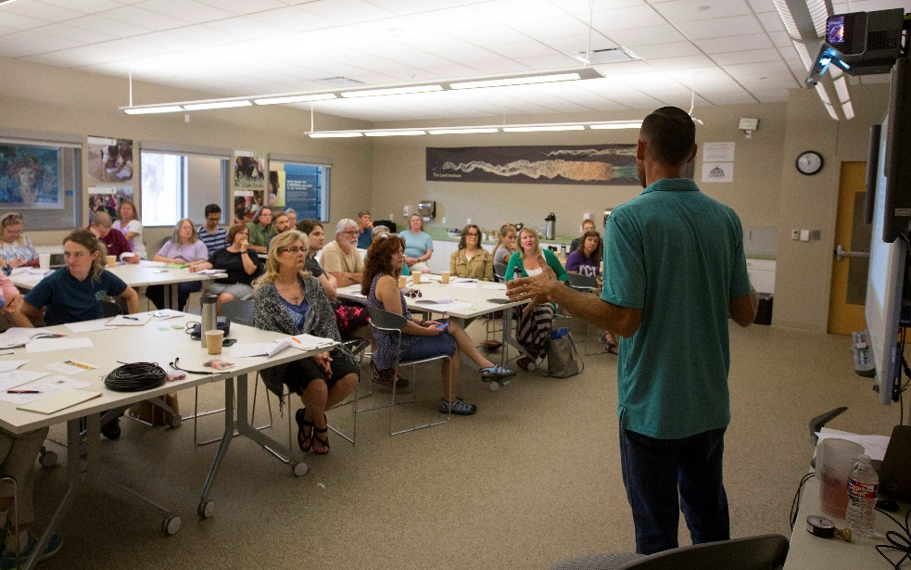
Horticulture & Gardening classes
Adult Education
Q1:Oct-Dec 17
Botany and Ecology classes
39
programs
227
participants
1010 engagement hours
Notes:
Pat – we were recommending to not use slide #10. If you want to hand something out on this you could.

Slide 14
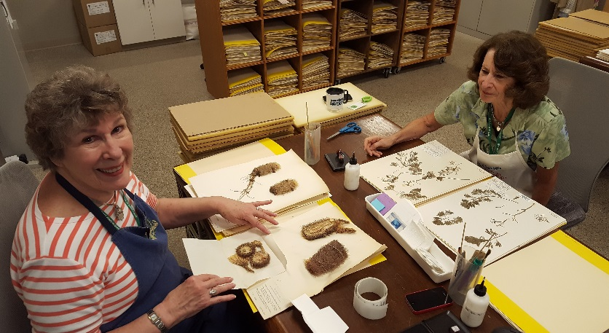
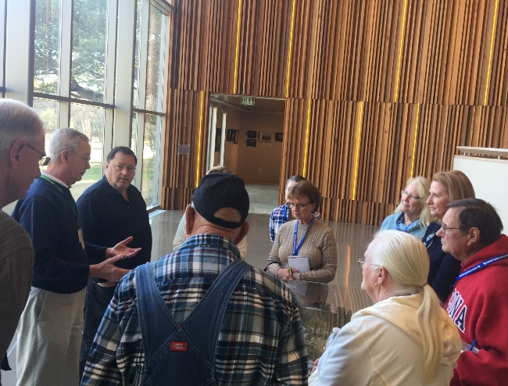
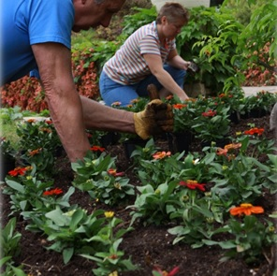
First Quarter results - Volunteers
Conserve
Engage
Volunteers
Q1: Oct-Dec 17
Explore
524
Volunteers
3605
Vol hours
2 full time staff equivalent
Cultivate
Notes:
After you complete this slide, “now I will turn it back over to Richard.

Slide 15
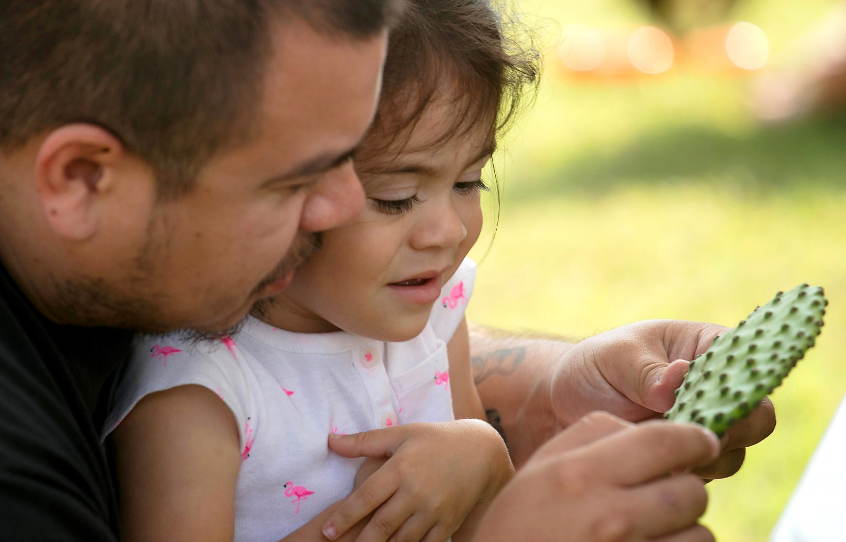
Come GROW with us…
Family
Discovery Day
March 3
1-4 pm
Fort Worth Botanic Garden
Free to the public!
Notes:
After you complete this slide, “now I will turn it back over to Richard.

Slide 16
Strategic Plan Next Steps
Primary focus - fund raising and membership
Determine the most effective model of management and operation
Non-profit receives retained funds from FWBS and FWGC
Notes:
Explore the establishment of or partnership with a non-profit entity
Primary focus – fund raising and membership
Non-profit receives retained funds from FWBS and FWGC
To use as “seed” money

Slide 17
Strategic Plan: Task Force
Purpose: To formulate prudent and judicious financial management policy recommendations that will strategically ensure the sustainability of the Fort Worth Botanic Garden and effectively maximize the full potential of the Garden as a world class museum.
Chair Person: Sal Espino
Members: Community members

Slide 18
Task Force Committee Members
Salvador Espino, Chair
John Avila
Greg Bird
Walter Dansby
Ralph Emerson
Jim Estill
Pete Geren
Laura Harrison
Sheila Hill
Adelaide Leavens
Marty Leonard
Elaine Petrus
Scott Wilcox
Julie Wilson
Mitch Whitten
Harvey Yamagata
Notes:
Chairman Salvador Espino – Former City Council Member
John Avila – Byrne Construction Services
Greg Bird – Chairman of Botanical Research Institute of Texas (BRIT)
Walter Dansby – Former Superintendent (FWISD) and current member of the Park & Recreation Advisory Board
Ralph Emerson – Rising Star Baptist Church and former Fort Worth Park Director
Jim Estill – Calloway Nursery and BRIT Board
Pete Geren – Sid W. Richardson Foundation
Laura Harrison – President of the Fort Worth Garden Club
Sheila Hill – Former Chair of the Park & Recreation Advisory Board and member of the Fort Worth Garden Club and the Fort Worth Botanical Society
Adelaide Leavens – President of the Meta Alice Keith Bratten Foundation, BRIT Board, and former Executive Director of Streams and Valleys
Marty Leonard – Community Advocate and Fort Worth Nature Center Board
Elaine Petrus – Community Advocate and member of the Fort Worth Garden Club
Scott Wilcox – CFO of the Amon G. Carter Museum of Western Art
Julie Wilson – Chair of the Convention and Visitors Bureau
Mitch Whitten – VP of Marketing and Communications at the Convention and Visitors Bureau
Harvey Yamagata – President of the Fort Worth Botanical Society

Slide 19
Strategic Plan: Task Force
3 task force meetings and 1 public meeting (February-April/May)
Overviews of Strategic Plan, Facility Assessment and Visitor Intercept Study
Review benchmark data from similar and local institutions
Recommend financial management policies and sources of revenue

Slide 20
Questions?

