Slide 1
Botanic Garden Accessibility Analysis
Fort Worth City Council Work Session
June 18, 2019
Susan Alanis, Assistant City Manager
Scott Wilcox, Amon Carter Museum of American Art
Bob Byers, Director, Fort Worth Botanic Garden
Notes:
SA

Slide 2
Purpose of Today’s Presentation
Clarify and obtain approval on accessibility options at the Fort Worth Botanic Garden
10/30/18 – Presentation on Fort Worth Botanic Garden Task Force Recommendations:
Admission fee with various accessibility options
Governance of the Garden should transition to non-profit management

Slide 3
Strategic Plan: Task Force
Purpose: To formulate prudent financial management policy recommendations that will strategically ensure the sustainability of the Fort Worth Botanic Garden and effectively maximize the full potential of the Garden as a world class museum while maintaining accessibility to all citizens.

Slide 4
Key concerns for the Task Force
Establish the current condition and long term needs of the Garden,
Determine what additional funding was needed to assure sustainability and review possible new funding sources,
Consider the impact of potential fees on the public and develop mechanisms that would assure accessibility, and
Evaluate various governance options and recommend which would best serve the Garden.

Slide 5
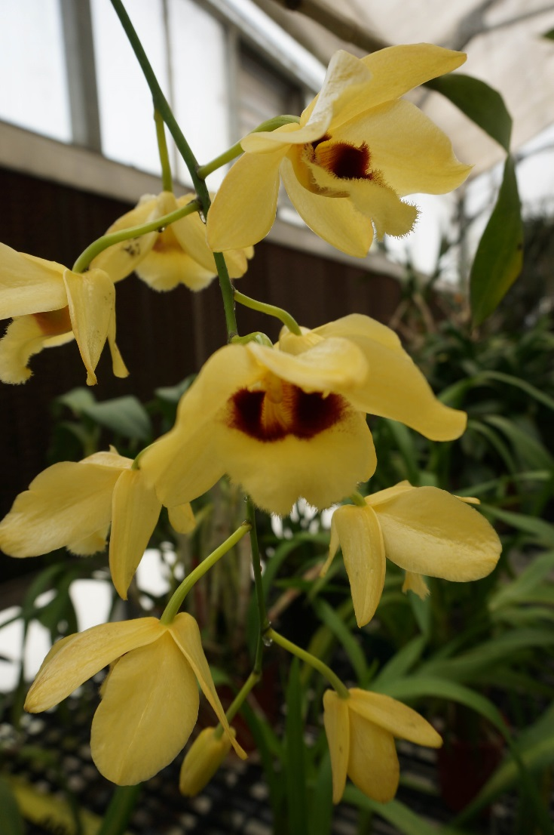
Revenue Goals
Find best compromise between revenue and affordability
Invest in programs that improve access
Engage and support families
Improve programming
Fully fund operating needs and address deferred maintenance
Notes:
SA

Slide 6
General Recommendation
An admission fee is necessary to accomplish these goals, but should be closely tied to accessibility options that allow all citizens to benefit from the Garden and its programs. It not only provides needed financial support, but also drives a robust membership program important for a successful development program.

Slide 7
Approved Fees
Admission: Adults: $12 | Child, 6 – 15: $6 | Senior, 65+: $10
Membership Level | Includes: Plus reciprocal privileges | Fee
Family | 2 named adults & all children <18 years in household | $100
Lone Star Family | Same as above | $30
Individual | One named adult | $50
Dual | Two named adults | $80
Contributing | Family plus 1 additional adult per visit | $200
Supporting | Family plus 2 additional adults per visit | $500
Sponsor | Family plus 2 adults per visit and 2 event tickets | $1,000
Notes:
SA

Slide 8
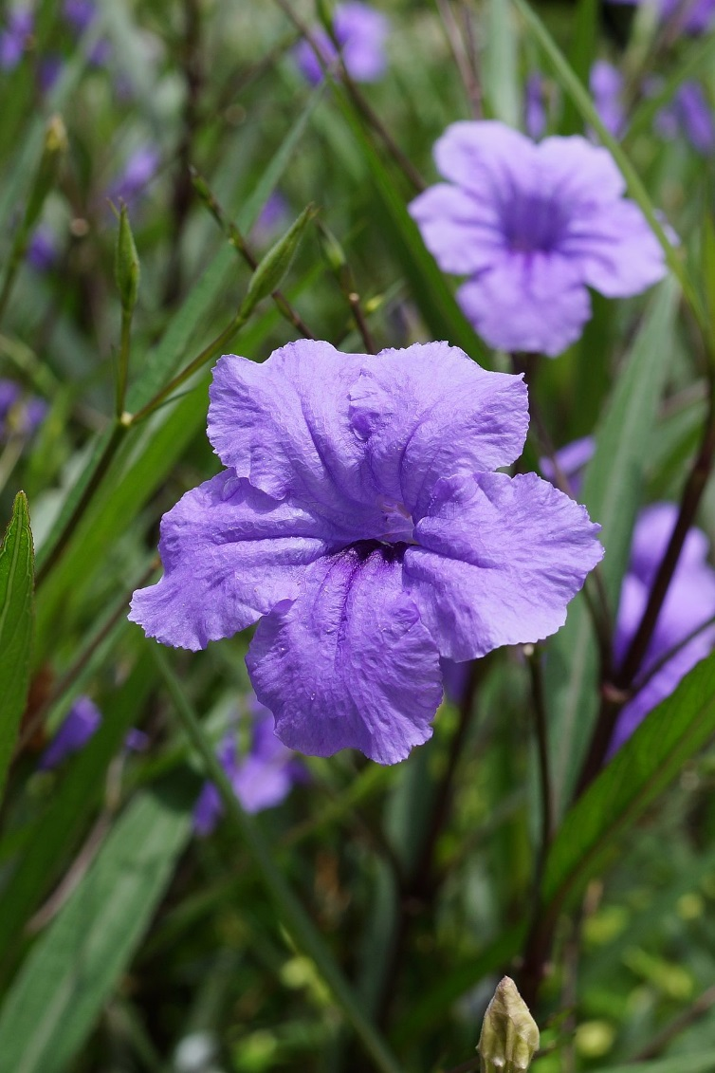
What the Research Says:
Free days as primary access strategy DO NOT change visitor demographics or reach underserved audiences
Well designed programs funded by adequate revenue DO improve access
Properly funded offerings and facilities build audiences, including underserved
Notes:
SA

Slide 9
Accessibility Goals
Provide multiple access options to the garden
Reduce impact on membership through carefully crafted programs
Avoid issues other institutions have experienced relying on free admission to assure accessibility
Notes:
SA, turn over to BB

Slide 10
Recommended Accessibility Options
Membership: Family membership
Lone Star Card Discounts, SNAP/WIC
Discounted Family Membership
Museums4All
3. MusePass
4. Sponsored Field Trips
5. Blue Star Program
6. Family Community Pass Program
Notes:
BB

Slide 11
Motion from 11/13/2018 M&C
Require City Council approval for any reductions or elimination of accessibility options
Staff to evaluate various free times
Fort Worth students or FWISD students
Free day each week---one suggestion to rotate the day to ensure convenience for all
Free hours at end of day for residents only
Free family day once per month
Directed staff to work with other cultural institutions to evaluate and return to City Council before fee implementation
Notes:
Mayor: work on one day per week free and access for FWISD students (added free times to amended motion option)
Carlos: Free family day once per month
Dennis: Free day per week rotating and access for FW students
Ann: Free at end of day for residents and Fort Worth students (not FWISD specific)

Slide 12
Additional Accessibility Review
Received input from eight Fort Worth cultural institutions
Conducted more detailed projections of task force
Prepared financial impact of five additional accessibility scenarios

Slide 13
Input Session With Cultural Institutions
Jessica Brandup | Kimbell Art Museum
Rob Denkhaus | Fort Worth Nature Center and Refuge
Mike Fouraker | Fort Worth Zoo
Patricia Harrison | Botanical Research Institute of Texas
Kendal Lake | Museum of Modern Art
Rena Lawrence | Log Cabin Village
Rebecca Rodriguez | Museum of Science and History
Scott Wilcox | Amon Carter Museum

Slide 14
Experience of Cultural Institutions
Assessment of Task Force Recommendation:
Proposal is generous
School programs introduce many children who may never visit with their families, but have important experiences and may return as adults
Currently approved options are already risking financial health
Consider phasing in options to gauge impact
Notes:
SA – keep quote? Discuss Rebecca’s role in the presentation. She is willing to come and speak. Had to speak with her supervisor.
“Do not confuse culture and income. Some audiences do not respond because they feel there’s nothing for them at your institution” Rebecca Rodriguez
Important to note that school programs are better when they can’t just show up and often have opportunities for underwriting.

Slide 15
Experience of Cultural Institutions
Role of Fees:
Perceived value (and respect for site and experience) increases
Free facilities/programs are more poorly attended than those with fees, which are seen as more worth the time
Notes:
SA

Slide 16
Experience of Cultural Institutions
Guest impact of Free Admission:
Free program on peak days resulted in overcrowding, poor visitor experience, complaints
Notes:
SA
Example of the Modern free on Sundays or Zoo half price Wednesdays during spring break.

Slide 17
Experience of Cultural Institutions
Demographic impact of Free Admission:
Does not increase visitation by target audience
National survey showed only $2-3k average household income difference between free and paid admission*
Zoo’s ½ price days: $5K decrease in average household income
Incorporating free family programming with targeted marketing has best response, not free admission
*Impacts Research and Development – National organization focusing on non-profits
Notes:
SA
“Data does not indicate a significant difference in annual household incomes to cultural organizations regardless of if they (visitors) paid to visit or if they got in for free.”
~ Colleen Dilenschneider, Impacts
Source of National survey – IMPACTS – national organization focusing on - CONFIRM

Slide 18
Experience of Cultural Institutions
Operational impact of free admission:
Additional staff needed for several hours or rotating days for anticipated increased attendance has scheduling and cost implications
Parking and traffic implications
Verifying residents versus non-residents can bog down admission process and result in guest dissatisfaction
Zip code discrepancies
Guests of residents
Notes:
Staffing 1 or 2 free hours is not cost effective as staff need reasonable shifts. 4-8 hours of labor costs to adequately staff 2 hours of business.
Separating residents/non-residents and/or managing some free hours during a day with admission charges overloads staff, increases guest dissatisfaction.

Slide 19
Recommended Accessibility Options
Membership: Basic Family Membership
Lone Star Card Discounts, SNAP/WIC
Discounted Family Membership - $30
Museums4All - $1.00 adult admission, children <15 free
MusePass – Free family passes in CFW public libraries
Sponsored Field Trips Program
Return ticket for field trips students on free and reduced lunch
Blue Star Program – free active military admission, Memorial Day – Labor Day
Family Community Pass Program – 4,500 passes through non-profits
Notes:
BB – needs to be consistent, be really clear on what we did. BB to get an answer from BRIT on what they are doing
Slide 7 needs to be revised or restated here to show the membership rates

Slide 20
Revised Recommendation
Adjusted basic family membership rates from $100 to $80
Proceed with all access options supported by task force
Fine-tune school group target grade to meet the needs of the districts
Add special needs adult children to family memberships
Add free after-hours (6-9pm) Family and Cultural Events at least quarterly, growing to monthly over time (e.g. Mariachi Concerts, Ethnic Foods Festivals)
Notes:
SA
Combined with Task Force Recommendations to provide wide range of accessibility options
Allows regular free access without impacting revenues
Does not overtax operational support
Provides membership marketing opportunities
Engages children and underserved audiences through relevant programs
Sponsorships and food/retail sales could offset costs

Slide 21
Options for Consideration
2nd/4th Monday: free 1st hour in a.m. & last hour in p.m., residents only
One 1/2 price Saturday morning, 3 hours, per month
Children < 18 years: free 3:00 p.m. - 6:00 p.m. every school day, residents only
Risk: Reduces admission and membership revenue by $108,850 and 35% overall loss in memberships
Notes:
SA – the children option is the one that will hurt us the worst. The other two will have an impact but not as great.

Slide 22
Task Force Recommendations*
Revenue Source | FY2019 | FY2020 | FY2021 | FY2022 | FY2023 | FY2024
Gross Revenue | $5,847,799 | $7,412,913 | $7,592,242 | $8,099,570 | $8,281,638 | $8,714,561
Total Expenses | $5,400,990 | $5,563,020 | $5,729,910 | $5,901,808 | $6,078,862 | $6,261,228
Net Revenue | $446,809 | $1,849,893 | $1,862,332 | $2,197,762 | $2,202,776 | $2,493,334
Debt Service | $0 | $756,281 | $915,000 | $868,313 | $847,563 | $826,813
Start-Up Costs | $460,000 | $640,000 | $0 | $0 | $0 | $0
Proposed Positions | $48,030 | $322,249 | $512,320 | $617,870 | $745,885 | $768,262
Balance to Programming | -$61,222 | $131,363 | $435,011 | $711,580 | $609,329 | $858,259
Operating Sustainability | -$1,213,192 | -$746,388 | -$252,668 | $129,450 | $155,214 | $426,521
*Figures Shown are Adjusted for Probability to Visit Based On Ability to Afford Admission
Notes:
Task Force requested $350,000 to jump start programming

Slide 23
Additional Options
All Task Force Recommendations
2nd/4th Monday: free 1st hour in a.m. & last hour p.m., residents only
Children < 18 years: free 3:00-6:00 p.m. every school day, residents only
One 1/2 price Saturday morning, 3 hours, per month
Revenue Source | FY2019 | FY2020 | FY2021 | FY2022 | FY2023 | FY2024
Gross Revenue | $5,847,799 | $7,304,062 | $7,477,868 | $7,979,674 | $8,156,220 | $8,583,620
Total Expenses | $5,400,990 | $5,563,020 | $5,729,910 | $5,901,808 | $6,078,862 | $6,261,228
Net Revenue | $446,809 | $1,741,042 | $1,747,958 | $2,077,866 | $2,077,358 | $2,322,392
Debt Service | $0 | $756,281 | $915,000 | $868,313 | $847,563 | $826,813
Start-Up Costs | $460,000 | $640,000 | $0 | $0 | $0 | $0
Proposed Positions | $48,030 | $322,249 | $512,320 | $617,870 | $745,885 | $768,262
Balance to Programming | -$61,222 | $22,512 | $320,638 | $591,684 | $483,910 | $727,318
Operating Sustainability | -$1,213,192 | -$855,239 | -$367,042 | $9,554 | $29,795 | $295,580
*Figures Shown are Adjusted for Probability to Visit Based On Ability to Afford Admission
Notes:
SA

Slide 24
Daily Free Periods Scenario
No Task Force Recommendations
Every day – last two hours free at evening, residents only
Revenue Source | FY2019 | FY2020 | FY2021 | FY2022 | FY2023 | FY2024
Gross Revenue | $5,847,799 | $7,210,532 | $7,382,647 | $7,882,761 | $8,057,615 | $8,483,324
Total Expenses | $5,400,990 | $5,563,020 | $5,729,910 | $5,901,808 | $6,078,862 | $6,261,228
Net Expenses | $446,809 | $1,647,512 | $1,652,737 | $1,980,953 | $1,978,753 | $2,222,097
Debt Service | $0 | $756,281 | $915,000 | $868,313 | $847,563 | $826,813
Start-Up Costs | $460,000 | $640,000 | $0 | $0 | $0 | $0
Proposed Positions | $48,030 | $322,249 | $512,320 | $617,870 | $745,885 | $768,262
Balance to Programming | -$61,222 | -$71,018 | $225,416 | $494,711 | $385,306 | $627,022
Operating Sustainability | -$1,213,192 | -$948,769 | -$462,263 | -$87,359 | -$68,809 | $195,284
*Figures Shown are adjusted for Probability to Visit Based on Ability to Afford Admission
Notes:
SA – This is JUST these recommendation and does not include the Task Force recommendations as noted.

Slide 25
Summary of Accessibility Scenarios
Scenario | Family Membership Impact | Average Balance | 5 Year Balance
Task Force Recommendations | 5% | ($300,313) | ($1,501,603)
Additional Options | -62% | ($420,109) | ($2,100,543)
Free Periods Daily | -90% | ($517,022) | ($2,585,108)
Notes:
SA

Slide 26
Schedule for Task Force Recommendations
Fort Worth City Council
Work Session – June 18, 2019
M&C – June 25, 2019
Staff
Complete and Launch Accessibility Programs:
June 26 – July 18, 2019
Admission Begins – July 19, 2019
Notes:
SA
Park and Recreation Advisory Board 2016: April 27, May 25, July 27, August 24
City Council: Informal Report No. 9880, May 3, 2016 “Report on the Fort Worth Botanic Garden Strategic Plan Process”

Slide 27
Discussion and Questions
Notes:
SA, BB

